Slide 1



Data Analysis of Customer and Sales Information
This presentation examines customer demographics, sales data, and product information across multiple countries. We'll explore key insights from our comprehensive dataset to inform business strategy.
by Rajan P

Slide 2

Data Cleaning: Ensuring Quality
1
Missing Value Handling
Implement strategies to address gaps in data. This may include imputation or deletion based on context.
2
Data Type Correction
Ensure each column contains the appropriate data type. Convert strings to numbers or dates as needed.
3
Duplicate Removal
Identify and eliminate redundant entries. This prevents skewed analysis and conserves storage space.
4
Irrelevant Information Filtering
Remove data that doesn't contribute to the analysis. This streamlines the dataset for efficiency.

Slide 3

CSV File Processing
1
File Loading
Use Pandas to import each CSV file into a DataFrame. This allows for efficient manipulation.
2
Initial Assessment
Examine data types, null values, and basic statistics. This guides the cleaning strategy.
3
Cleaning Application
Apply cleaning operations to each DataFrame. Ensure consistency across all files.
4
Quality Check
Verify the cleaned data meets quality standards. Address any remaining issues.

Slide 4
Column Identification for Merging
Unique Identifiers
Date Fields
Common Attributes
Locate primary keys that uniquely identify each record. These are crucial for accurate merging.
Identify temporal data for time-based analysis. Ensure consistent formatting across files.
Find shared fields across files. These provide additional merge points and enrich the dataset.

Slide 5
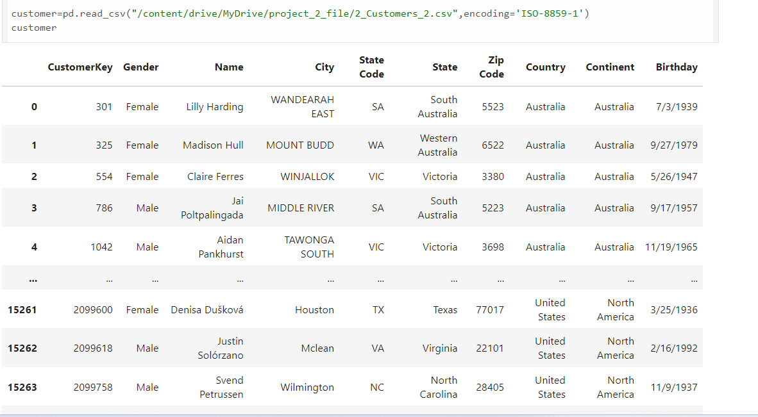
CLEANING PROCESS

Slide 6
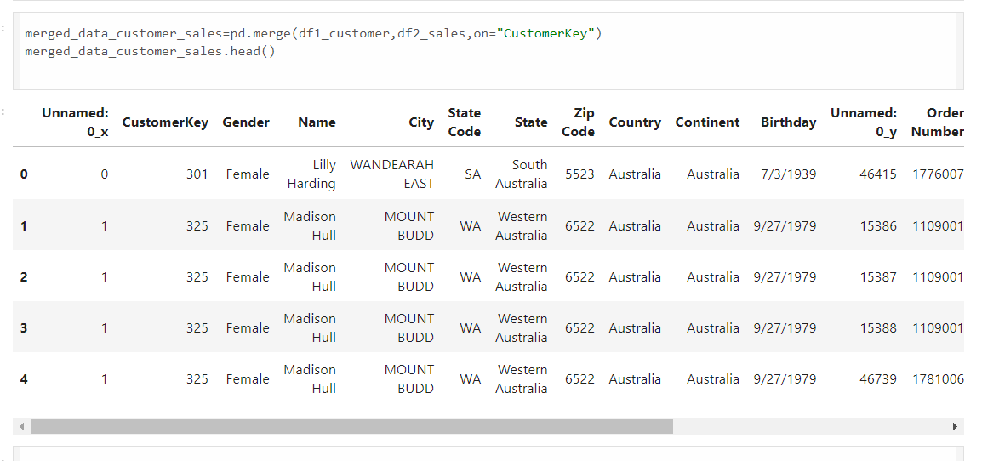
MERGING PROCESS

Slide 7
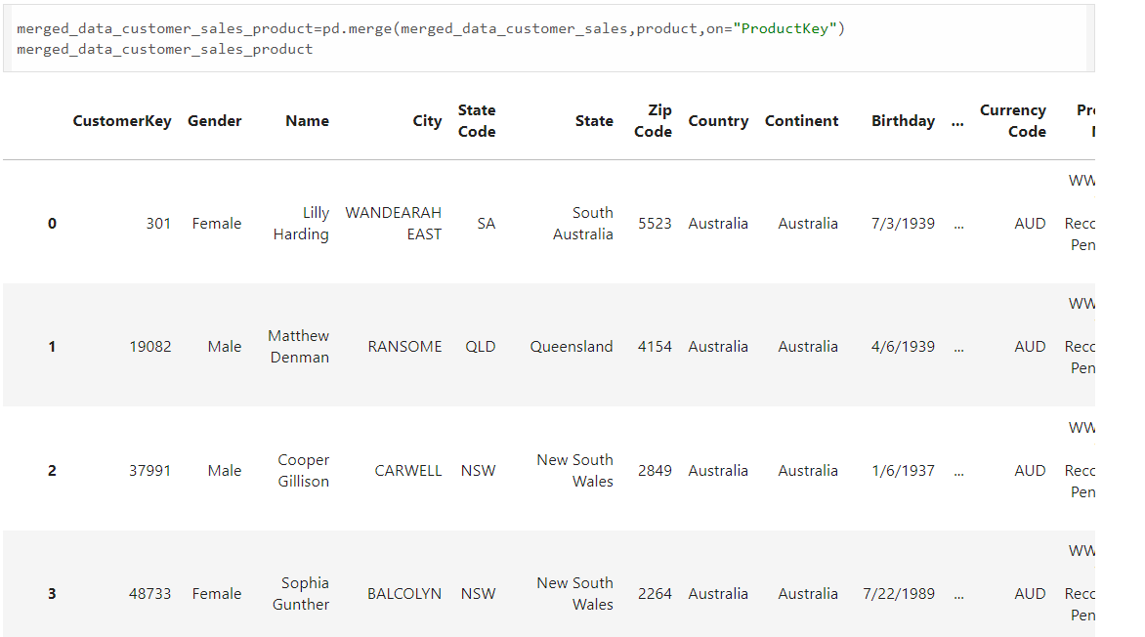
MERGING PROCESS

Slide 8





Data Merging with Pandas
Initial Merge
Start with two DataFrames. Use pd.merge() with appropriate join type.
Iterative Joining
Progressively merge additional DataFrames. Ensure key columns align properly.
Conflict Resolution
Address any column naming conflicts. Use suffixes or rename as needed.
Final Validation
Verify the merged dataset's integrity. Check for unexpected null values or duplicates.

Slide 9
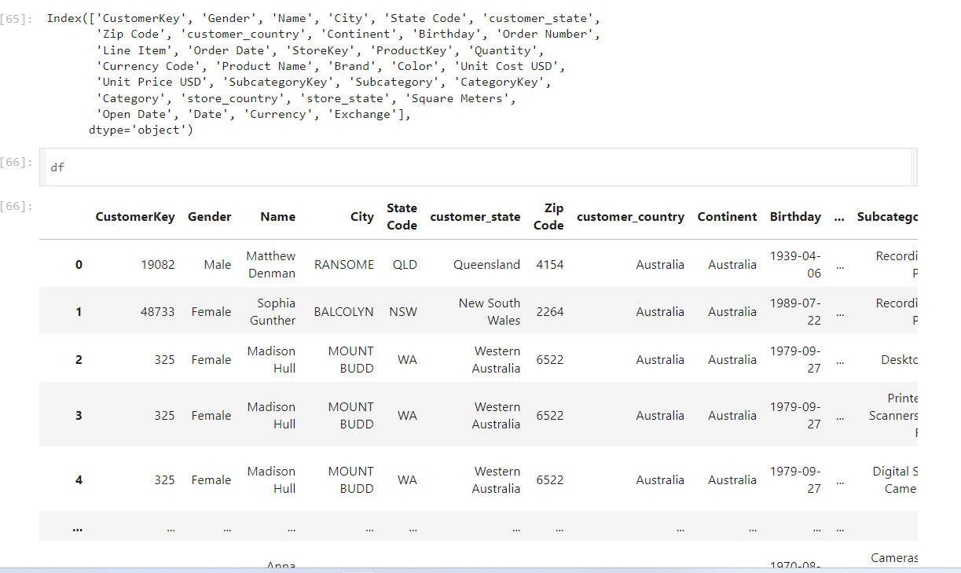
AFTER CLEANING & MERGING

Slide 10
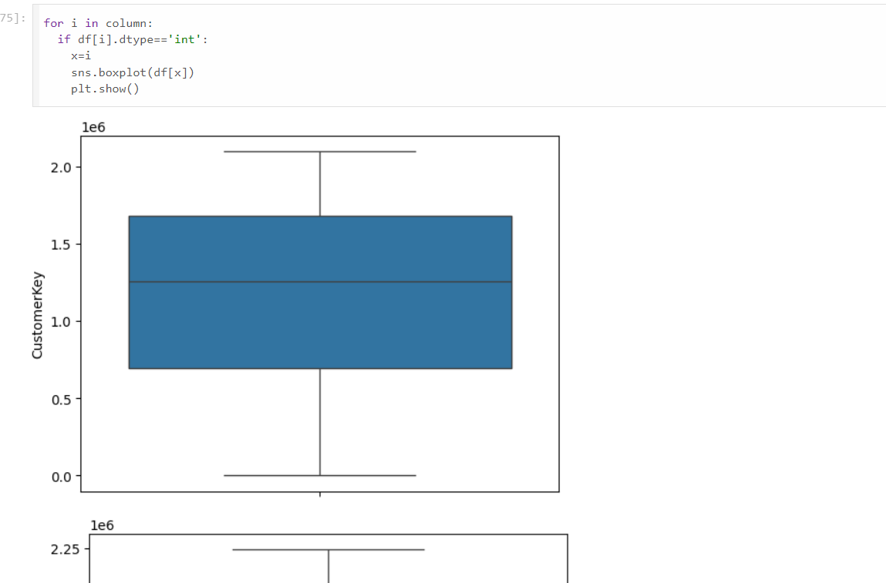
OUTLIER CHECKING PROCESS

Slide 11

AWS Setup for Data Storage
EC2 Instance
Launch an EC2 instance to host the MySQL database. Choose appropriate specifications.
Security Group
Configure inbound rules to allow MySQL connections. Ensure proper security measures.
RDS Alternative
Consider using Amazon RDS for managed MySQL. This simplifies administration tasks.
IAM Roles
Set up IAM roles for secure access. This enables controlled data management.

Slide 12

Python-MySQL Integration
1
Library Installation
Install required Python libraries. This typically includes SQLAlchemy and pymysql.
2
Connection String
Create a connection string with host, user, password, and database details.
3
Engine Creation
Use SQLAlchemy to create an engine. This facilitates communication with MySQL.
4
Data Transfer
Use to_sql() method to push DataFrame to MySQL. Specify table name and if_exists parameter.

Slide 13
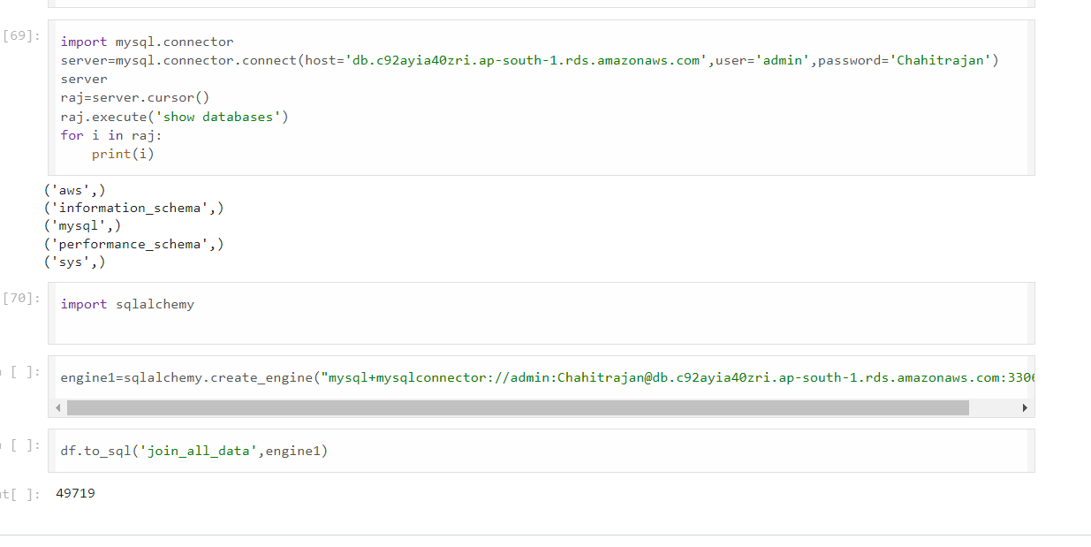
DATA PUSH TO MYSQL

Slide 14





Power BI Connection to MySQL
Data Source
Add MySQL as a data source in Power BI. Provide connection details.
Data Transformation
Use Power Query to shape and clean data if necessary.
Data Modeling
Create relationships between tables. Define measures and calculated columns.
Refresh Settings
Configure data refresh schedule. Ensure timely updates for the dashboard.

Slide 15
Dashboard Design in Power BI
Key Metrics
Trend Analysis
Comparative Views
Identify and highlight critical KPIs. Use cards or gauges for clear visibility.
Implement line and area charts. Show data patterns over time.
Use bar charts and scatter plots. Enable stakeholders to compare different data aspects.

Slide 16
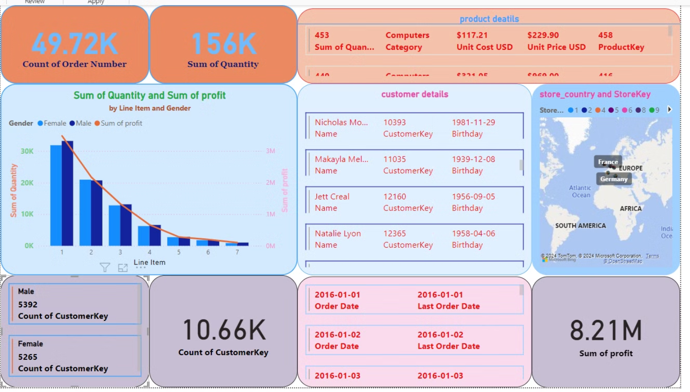
POWER BI (DASH-BOARD)

